Slide 1
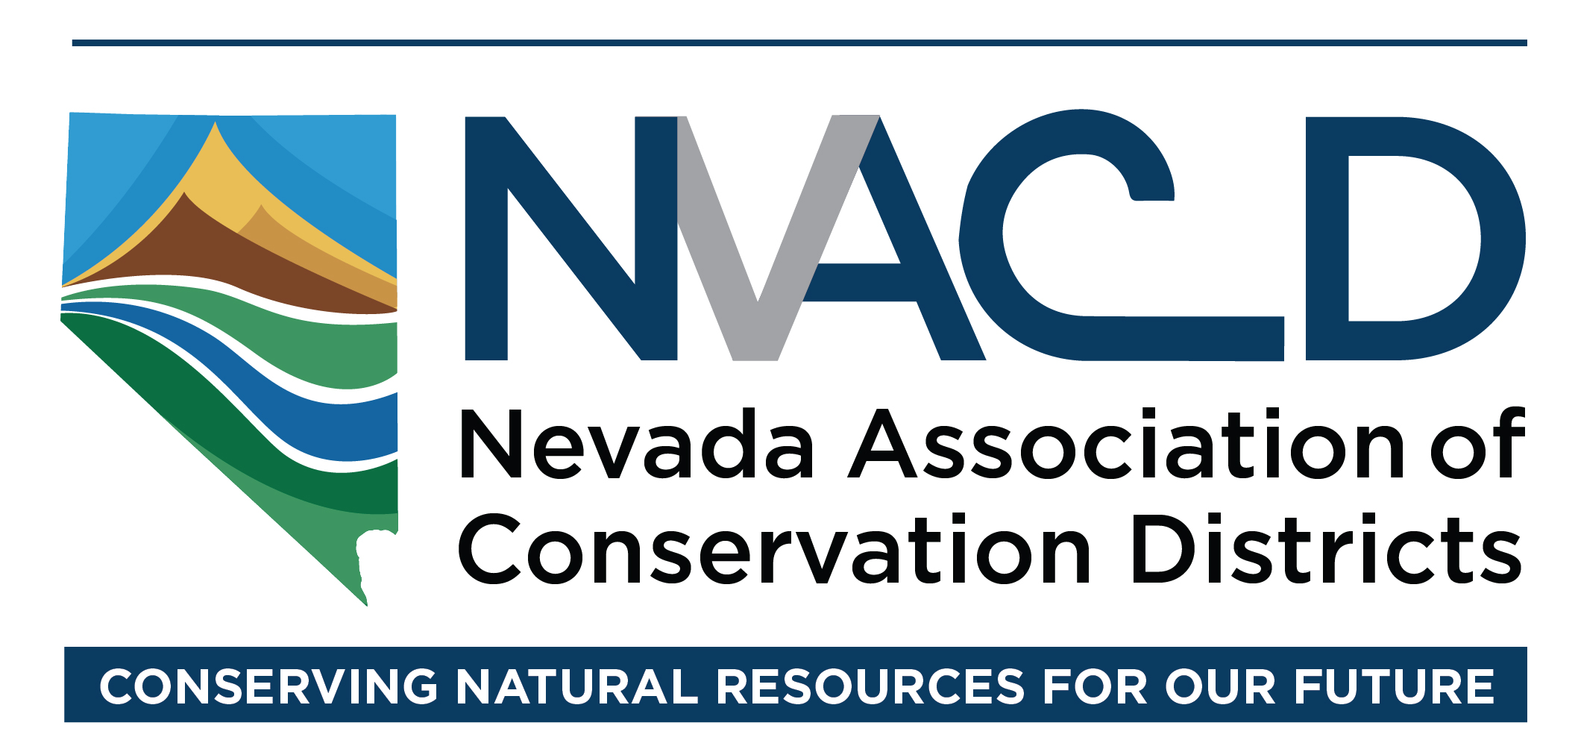
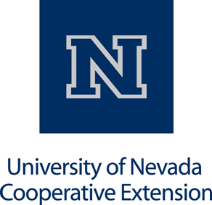
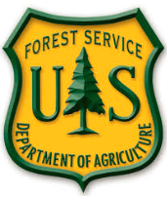
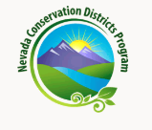
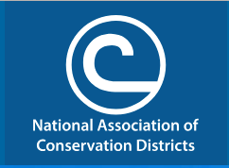
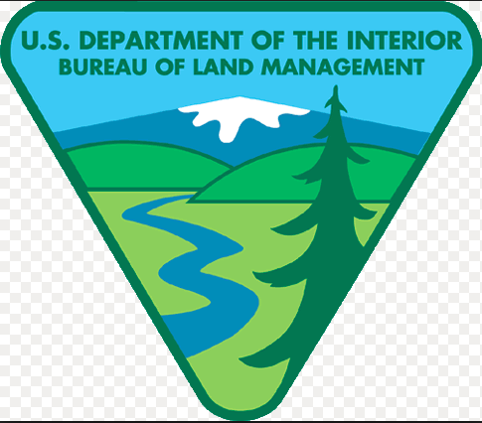
Resource Needs Assessments
Notes:
Our RNA process is being supported financially by these agencies. Our thanks to them.

Slide 2
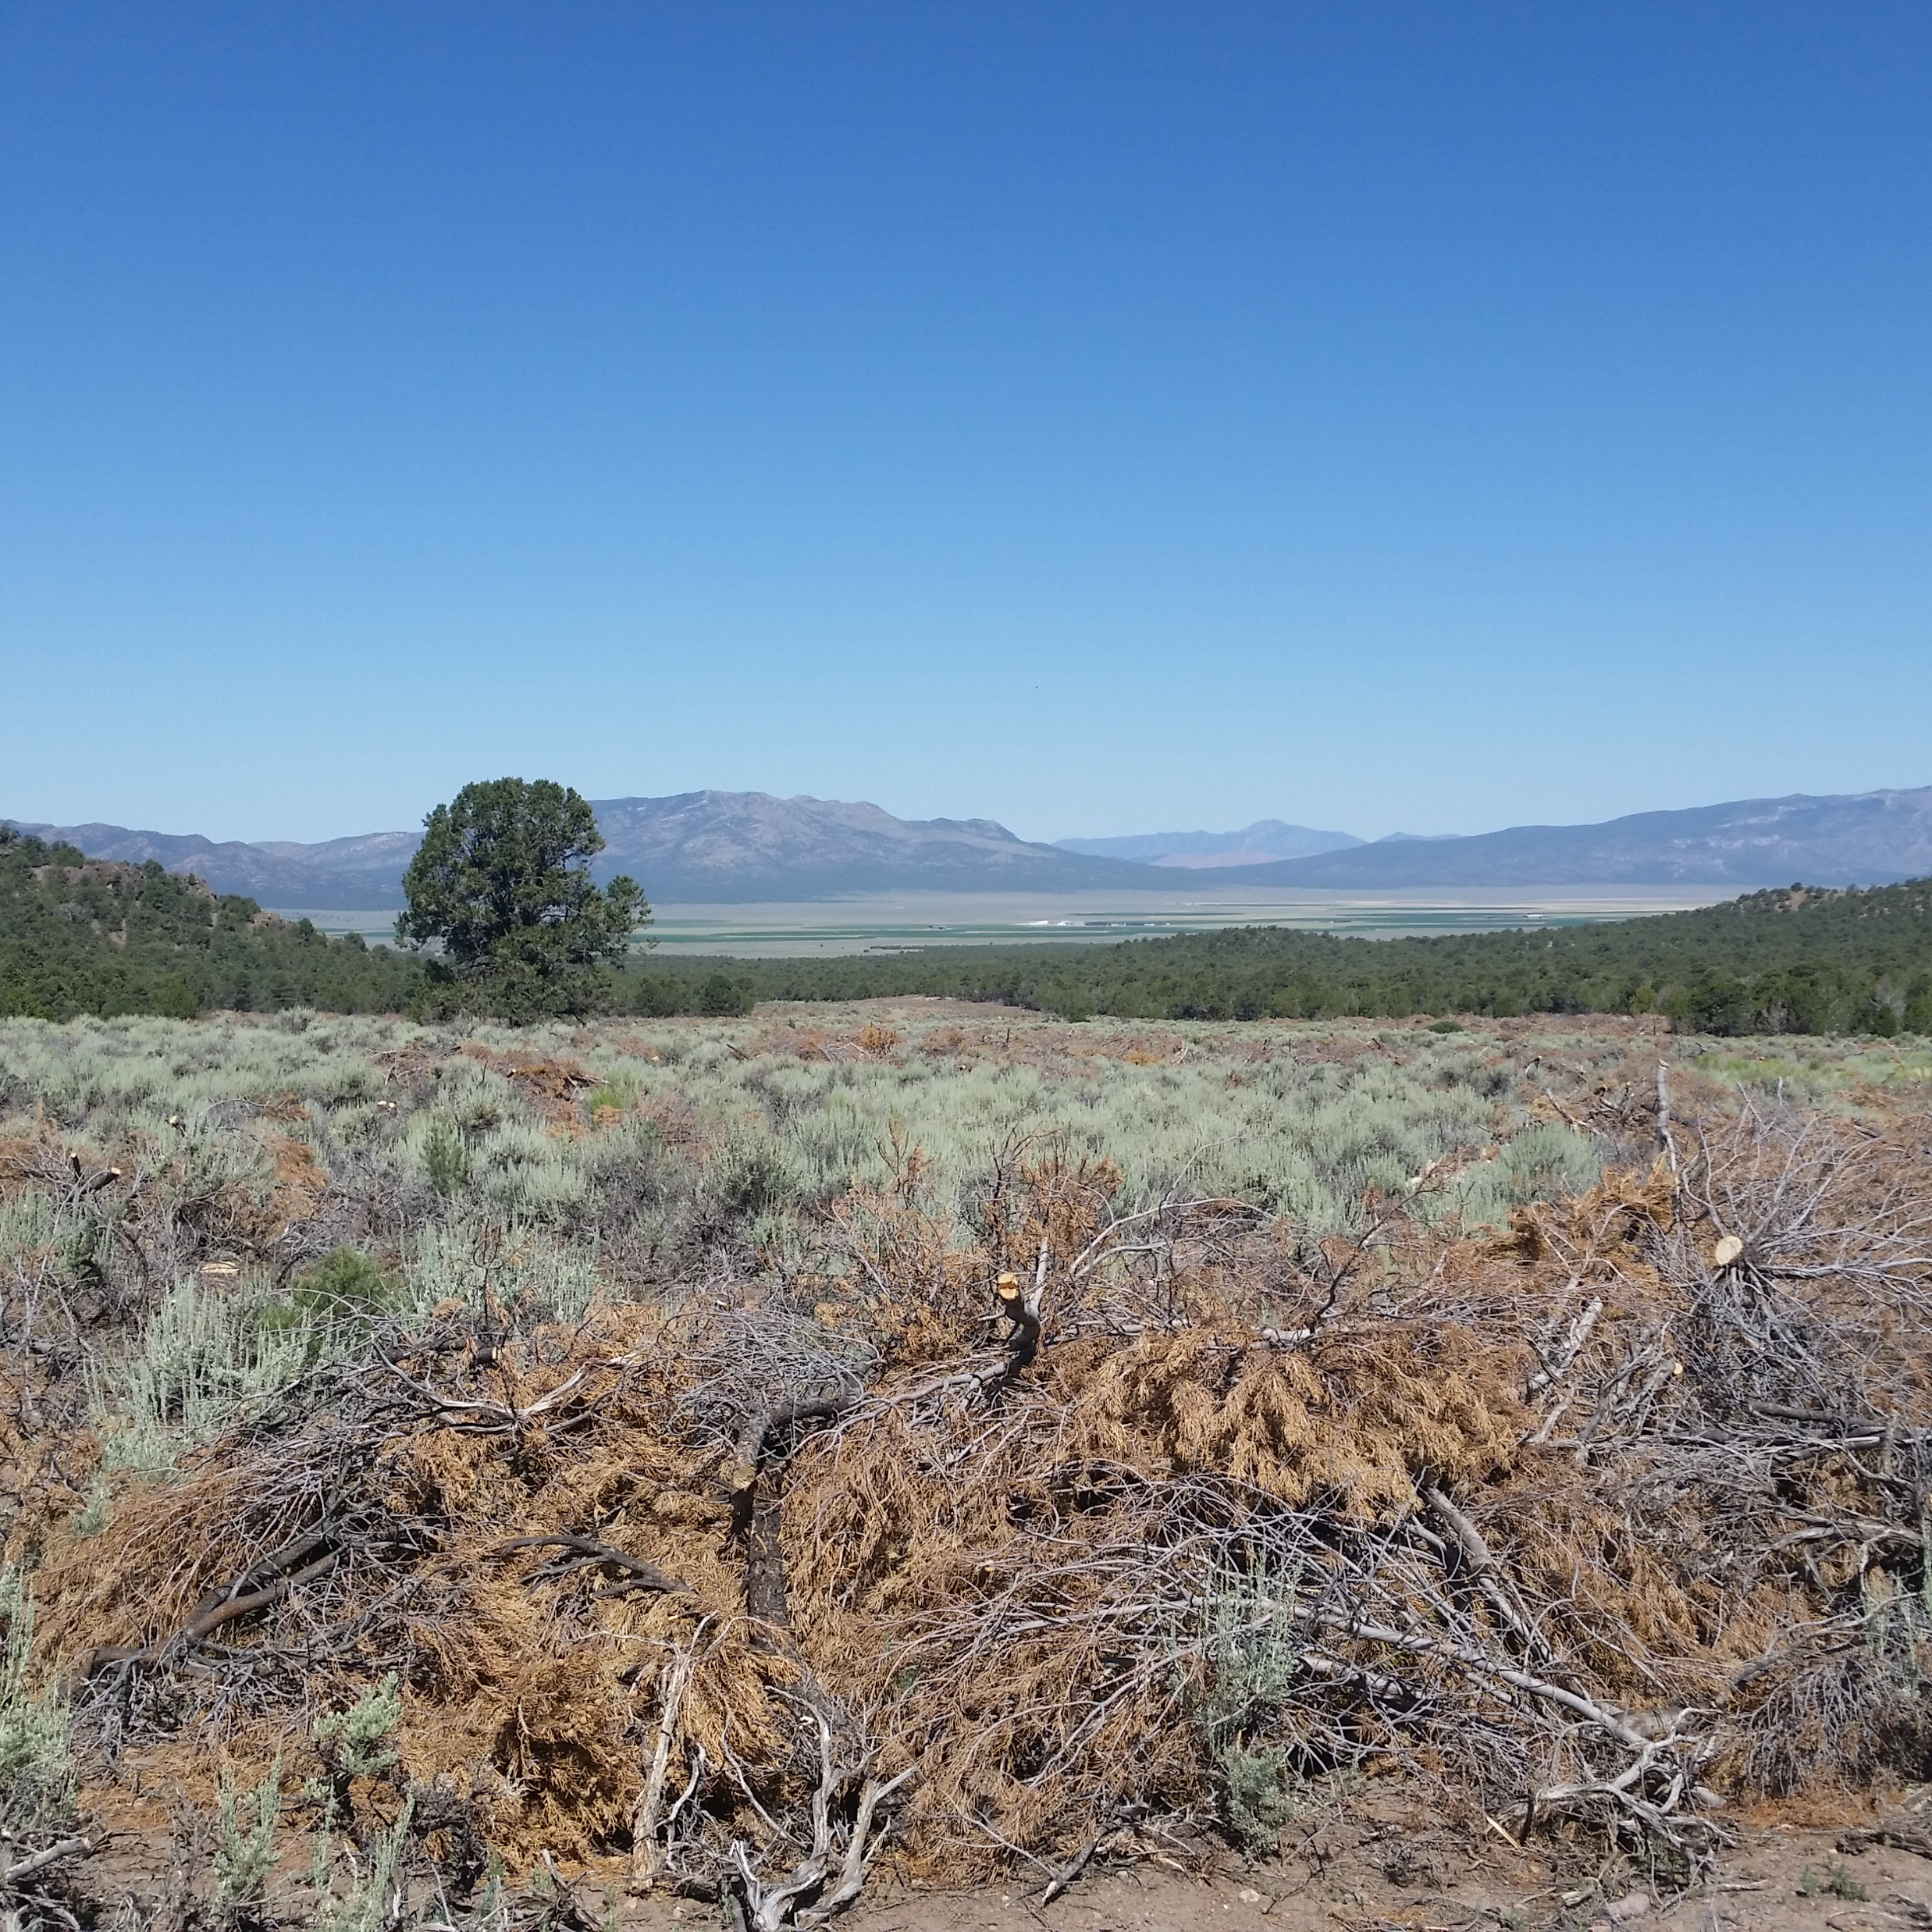
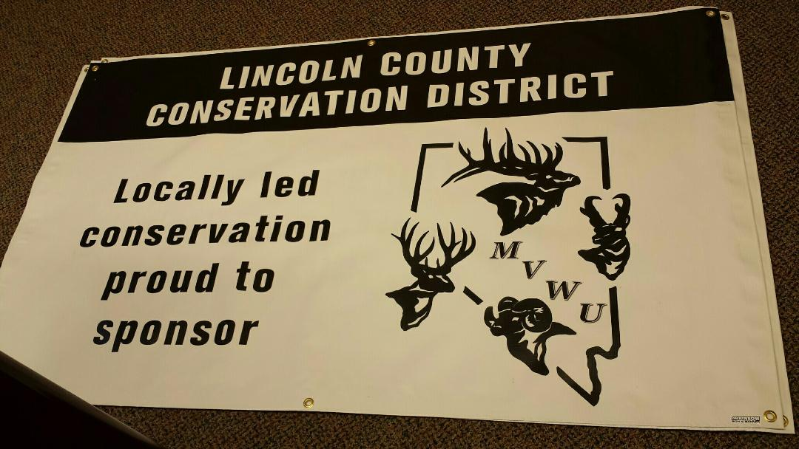
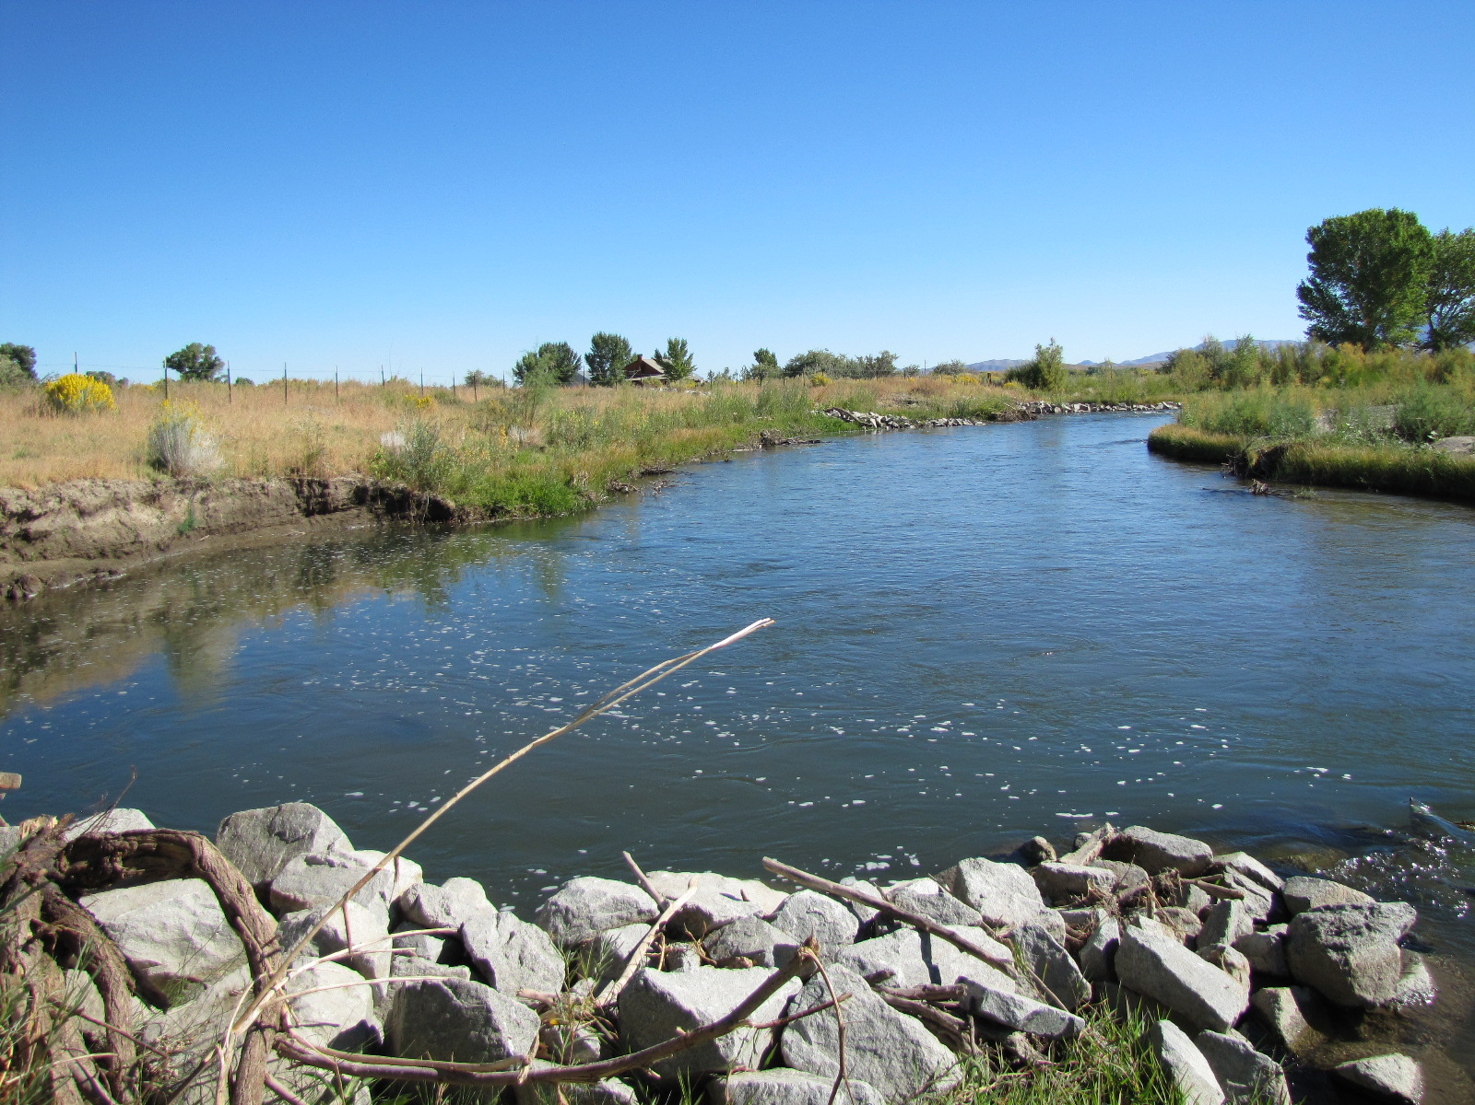
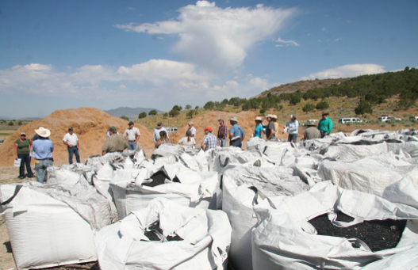
Notes:
Restoration on Nevada’s rivers, here the Walker River. Pinyon-juniper encroachment removal for sage grouse, wildlife and increased water in many locations around the state. Biochar project near Eureka. Partnerships with local groups, here Meadow Valley Wildlife Unlimited in Lincoln County

Slide 3
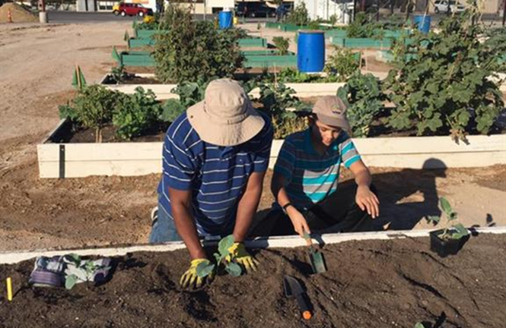
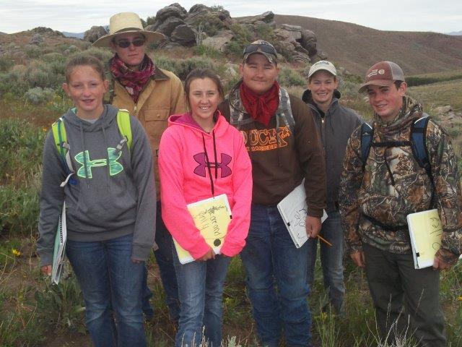
Who is doing all this great stuff and more?
Nevada’s Conservation Districts!
Notes:
Zion Community Garden in Las Vegas. Supporting Nevada Youth Range Camp.

Slide 4
What is a Conservation District?
Founded in 1937 during the Dust Bowl
With a philosophy that conservation decisions should be made at the local level
Focusing on voluntary, incentive-based actions.

Slide 5
What is a Conservation District?
Governmental entities, much like school boards, directed by locally elected Supervisors
Authority comes from NRS 548
A vital link to connect private and public land interests in Nevada; they encompass all Nevada
Notes:
Conservation Districts started because in the 1930s people understood something - if you want the government to help; it will work much better if local people guide it. NvACD is part of the movement to make that thought the way we do business in Nevada again.

Slide 6
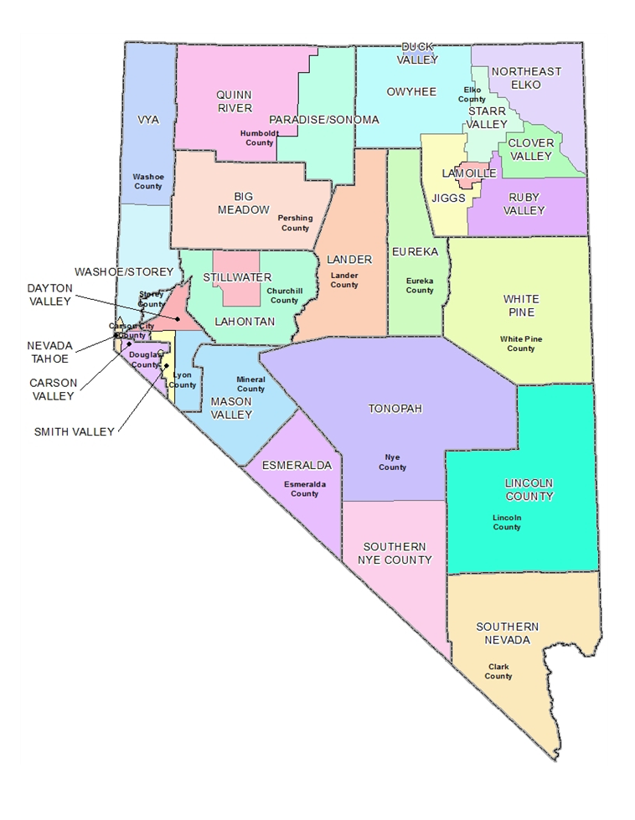
Notes:
Nevada’s 28 CDs include the whole state.

Slide 7
Notes:
NvACD is the non-profit, statewide network, voice, and advocacy association for Nevada CDs. We provide forums and training to educate CD Supervisors and others; we can lobby and are not subject to the open meeting law like CDs and the State Conservation Commission. We also recognize outstanding conservation work at our Annual Meeting and assist CDs to reach their potential.

Slide 8
NvACD is helping CDs increase their role as leaders of locally led conservation in Nevada
An initial group of Nevada CDs will write Resource Needs Assessments
A CD will bring together local producers, local groups, agencies and general public to identify RESOURCE CONCERNS and possible solutions to those resource concerns using NRCS farm planning tools and other resources.
This information will be used to write Conservation Action Plans that can serve to direct programs and funding from any source to resolve those resource concerns.
Resource needs will drive the conservation actions and funding will be spent on the priority resource concerns as determined by local stakeholders
Notes:
(SLOWLY READ THE BULLET POINTS) Note the words, “Resource concerns or needs” in each bullet point and emphasized right in the center! This process is effective because it is driven by resource concerns, not programs. It answers the question of what the resource concerns are BEFORE human traditions, wants, needs, values, biases, emotions or political position can cloud the issue. When the resource concerns are identified first, it keeps the human part from inadvertently dominating. It makes the focus be how to solve the resource issue at hand. This method will seek the most appropriate outcome, even if that may not appear to be the most desired at first blush. (Think of any contentious issue)

Slide 9
NvACD is helping CDs increase their role as leaders of locally led conservation
HOW? By partnering and leveraging opportunity
Funding and training
NV-NRCS Agreement
Outreach and training
Coordination and support
Renewing 2016 RCPP grant commitments
BLM, USFS, NDF, NDOW, USFWS, CD Program
Provide staff to assist gathering input and compiling the Resource Needs Assessment
NACD grant
Increasing public input
Develop sophisticated survey instrument with help of UNCE and UNR
Notes:
NvACD signed a Cooperative Agreement in 2017 with Natural Resources Conservation Service in Nevada; NRCS sought to increase the effectiveness of CD-led Local Work Groups and their State Technical Advisory Committee and NvACD will train and educate the initial seven CDs and the agencies, groups, and local publics that will help them develop the Resource Needs Assessments to accomplish that. *** Agencies are committing staff time and project funding to the Resource Needs Assessment process. NvACD obtained funding from the National Association of Conservation Districts to hire retired NRCS employees who already understand the farm planning tools to help the seven CDs develop the Resource Needs Assessments. *** NvACD is also working with University of Nevada Cooperative Extension for funding, and UNR to develop, a sophisticated survey instrument to improve the amount and quality of public input to the process. The seven CDs are Lincoln County, Northeast Elko, Eureka, White Pine, Mason Valley, Smith Valley and Conservation District of Southern Nevada.

Slide 10
Benefits to a CD and Their Local Area
• Inform NRCS State Technical Advisory Committee
• A plan in place to coordinate and cooperate with federal agency planning
• Able to direct funding from any source toward appropriate conservation projects
• Assist a County with local planning to address local resource concerns
• Mechanism for a Local Work Group (LWG) to function and fulfill its responsibilities
• Furtherance of partnerships begun by varied sage grouse efforts
Notes:
There are many benefits to a CD and their local area.
It is all about having the information in place to make the best decisions, at the local level, about how best to spend any program dollars available from any source to solve resource concerns, and how to locally lead planning for the future.
This “Locally Led” planning process establishes a foundation upon which the District’s conservation efforts are based. It provides the informational and scientific rigor for planning and project implementation that is on par with other federal agency planning, and provides the context to develop collaborative solutions with state and federal partners. It challenges neighbors, both urban and rural, to work together and take responsibility for addressing local resource needs. It involves the community in the assessment of those needs, as well as the solutions and priorities. The approach emphasizes voluntary, non-regulatory, incentive-based actions before use of regulatory measures. It is not driven by any single piece of legislation, any one fiscal year or any individual program; it is an on- going, timeless approach that is not tied to any particular year. As such, it is able to be evaluated regularly to ensure it is effectively meeting the long-term needs of the local community.

Slide 11
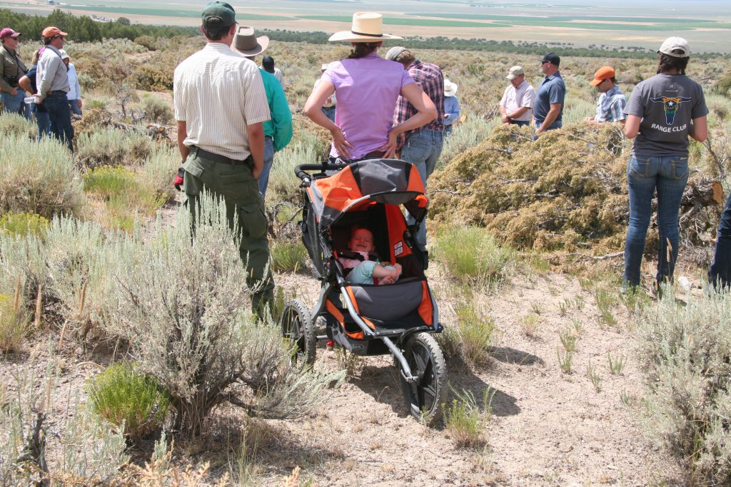
All this is driving toward Locally-led Conservation,
based on the obvious premise that local people make the best decisions
for their own communities.
Notes:
Conservation Districts are statutorily the local group with the most authority and responsibility to lead locally led conservation across ownership boundaries; they are ideally suited to be the leaders to bring the concerns and planning from multiple agencies and groups together for the best result per NRS 548.

Slide 12
How you can help
Provide accurate, relevant input to identify the resource concerns
Offer staff time to participate in the Resource Needs Assessment and support the decisions made
Direct funding to projects identified by the process
Help distribute the survey and encourage response
Participate or nominate participants for the LWG, State Technical Advisory Committee, and CD
Involve your CD in local management
Provide specialists to analyze unidentified, or identified but unquantified problems, so we can begin to address them
Volunteer to be part of the solutions when opportunities arise; find ways to say YES!
Notes:
We know you can find yourself or your agency or group somewhere on this list. The Resource Needs Assessment has the opportunity to find solutions for resource concerns in your area, and is an obvious and practical way to build relationships; everything is always about relationships. And most of all, find ways to say YES and anything is possible!

